Slide 1
Design of RF & Microwave Systems
EEC 134 A&B
Lecture 3: Building Blocks of RF Systems
– RF Amplifiers
Xiaoguang “Leo” Liu
Assistant Professor
School of Electrical and Computer Engineering
Tel: 530-289-6367
lxgliu@ucdavis.edu
http://ucdart.net

Slide 2
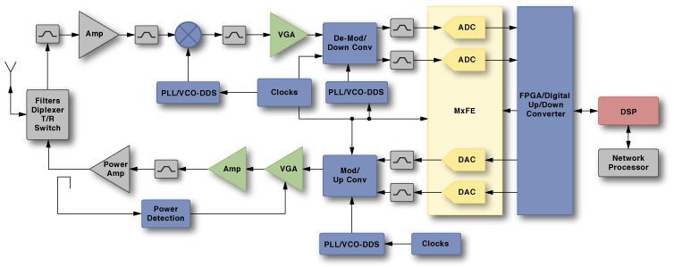
Amplifiers in RF/Microwave Systems
The function of an amplifier is simple: to amplify signals
Recall from last lecture the typical strength of a GPS signal: -125 dBm; that is a ridiculously small power: -125 dBm ≈ 10⁻¹⁵ W!
We want to make this signal stronger, actually a lot stronger, in order to be able to process it; all without distorting it in any way
Similar need is in the transmitter: signal generated by the oscillator is often quite weak; needs a lot of amplification before transmitting it in order to reach longer distances
Different kinds of amplifiers are tailored to specific system functions
Low Noise Amplifier
Variable Gain Amplifier
Generic Gain Block
Power Amplifier
Variable Gain Amplifier

Slide 3
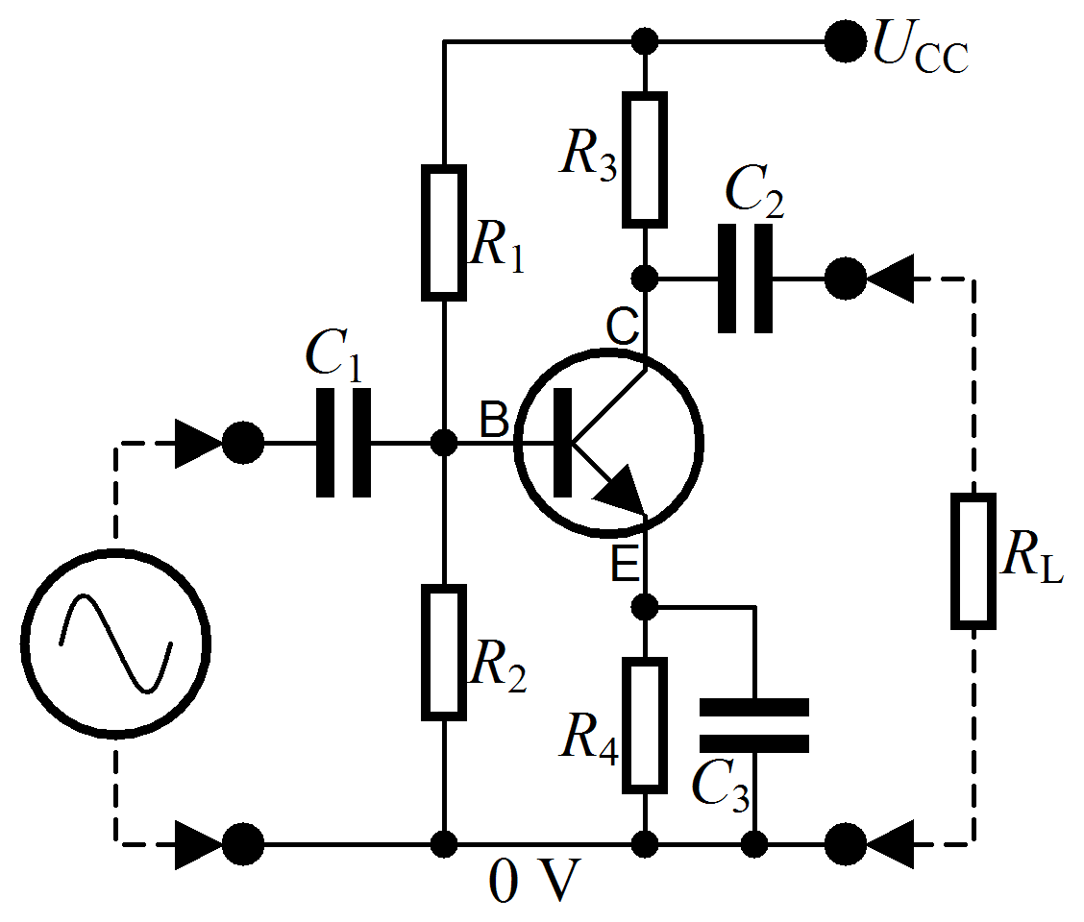
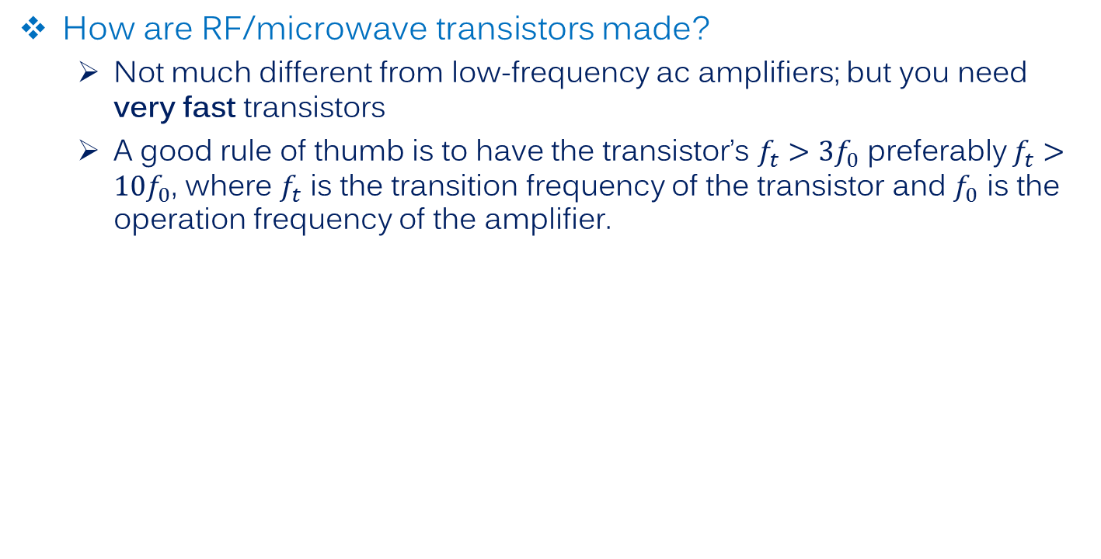
Amplifiers in RF/Microwave Systems
How are RF/microwave transistors made?
Not much different from low-frequency ac amplifiers; but you need very fast transistors
A good rule of thumb is to have the transistor’s $f_{t}>3f_{0}$ preferably $f_{t}>10f_{0}$, where $f_{t}$ is the transition frequency of the transistor and $f_{0}$ is the operation frequency of the amplifier.
A common emitter amplifier for RF frequencies
Notes:
Include the internal model of the transistor

Slide 4

Amplifiers in RF/Microwave Systems
How are RF/microwave amplifiers made?
Not much different from low-frequency ac amplifiers; but you need very fast transistors.
A good rule of thumb is to have the transistor’s $f_{t}>3f_{0}$ preferably $f_{t}>10f_{0}$, where $f_{t}$ is the transition frequency of the transistor and $f_{0}$ is the operation frequency of the amplifier.
V_{cc}
input
A
output
GND
Notes:
Include the internal model of the transistor

Slide 5
An Ideal RF/Microwave Amplifier
Infinite bandwidth
Constant gain
Signal travels only from input to output (unilateral)
Perfectly matched at the input and the output
No signal distortion
Doesn’t add noise to the signal
Doesn’t change the shape (either in amplitude or phase) of the signal
Amplifies any level of signal
100% efficient
Finite bandwidth
Gain variation, even within the bandwidth
Single feedback from output to input!
Finite (and sometimes intentional ) mismatch at the input/output
Signal distortion
Noise
Amplitude
Phase (less of a concern)
Limited output power (of course!)
<100% efficiency (of course!)

Slide 6
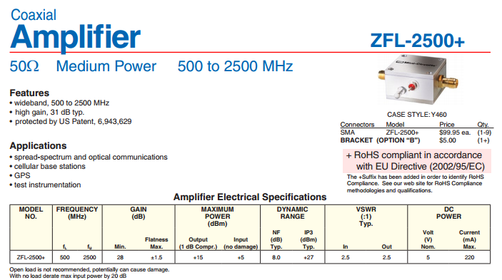
An Example of a Real-World RF Amplifier
Frequency Range
Power Limitations
Linearity (Amplitude Distortion)
Efficiency
Gain Variation
Noise
Matching

Slide 7
Amplifier Noise

Slide 8
Where Does Noise Come From?
Noise sources within typical amplifiers:
Thermal noise, thermal vibration of bound charges, such as in a resistor
Shot noise, random fluctuation of charge carriers in an electron tube or solid-state device
Flicker noise, fluctuation in a direct current, and found in both electron tubes and solid-state devices. Also known as 1/f noise

Slide 9
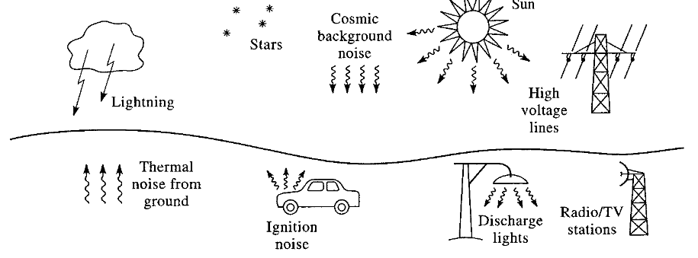
Origins of Noise
External:
Thermal noise from the ground
Cosmic background radiation from the sky
Noise from stars (including the Sun)
Lightening
Gas discharge lamps
Radio, TV, and cellular stations (interferers)
Other wireless devices

Slide 10
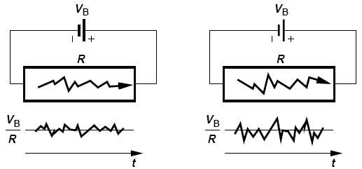
Thermal Noise
A resistor not connected to anything can have a voltage across it
The average voltage is of course 0 and its amplitude is random and very small
Random motion of charge carriers produce a random variation of voltage (or current) with respect to time → noise voltage and/or noise current
A conductor (equivalently a resistor) has lots of charge carriers
The higher the temperature, the more random motion, and therefore the higher the noise
Lower T
Higher T
Notes:
The random motion of the electrons creates a voltage across the two terminals, the

Slide 11
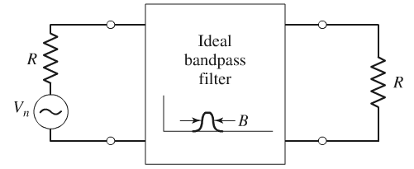
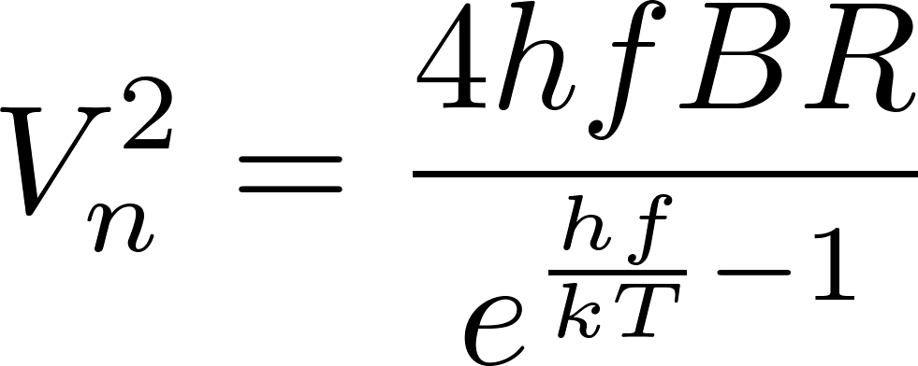
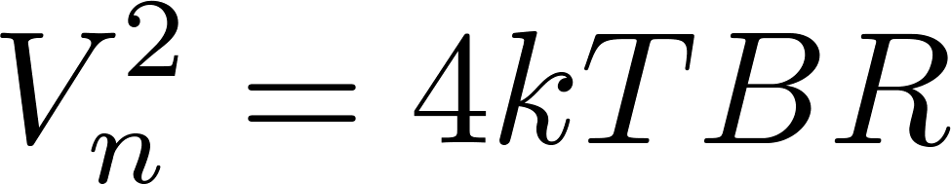
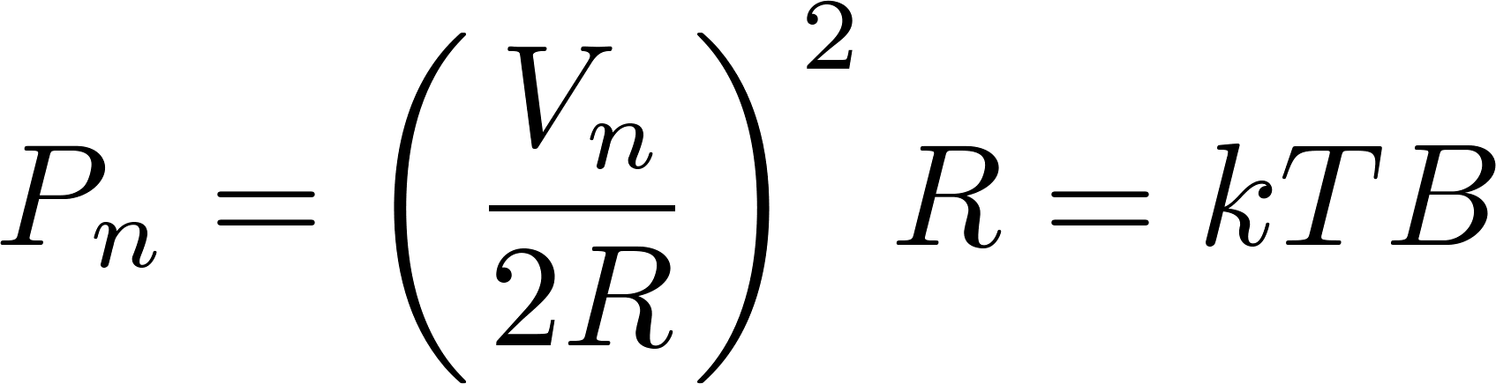
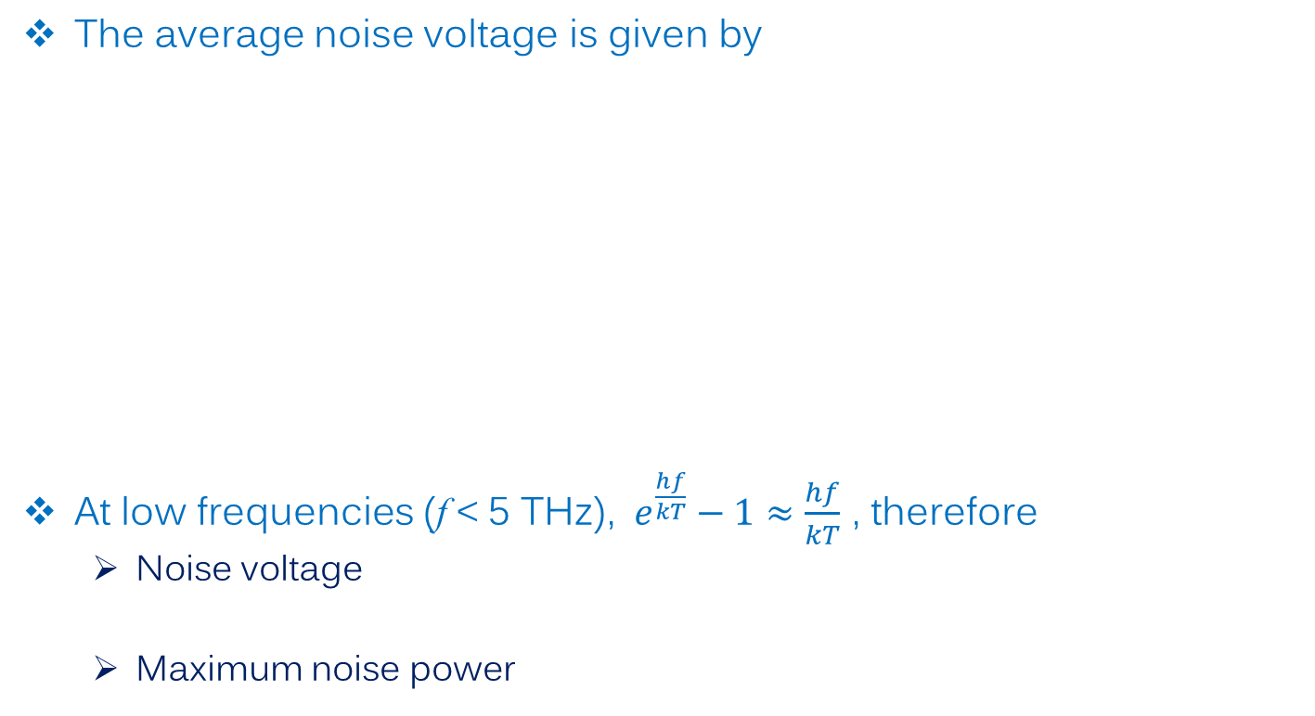
Thermal Noise – Noise Voltage and Noise Power
The average noise voltage is given by
At low frequencies (f < 5 THz), $e^{\frac{hf}{kT}}−1≈\frac{hf}{kT}$ , therefore
Noise voltage
Maximum noise power
*
h = 6.626 x 10⁻³⁴ J∙s, Planck’s constant
k = 1.38 x 10-23 J/K, Boltzmann’s constant
B, bandwidth in Hz
f, center frequency of the bandwidth
R, resistance in Ω
T, temperature in Kelvin
* For derivation, refer to: http://www.pas.rochester.edu/~dmw/ast203/Lectures/Lect_20.pdf

Slide 12
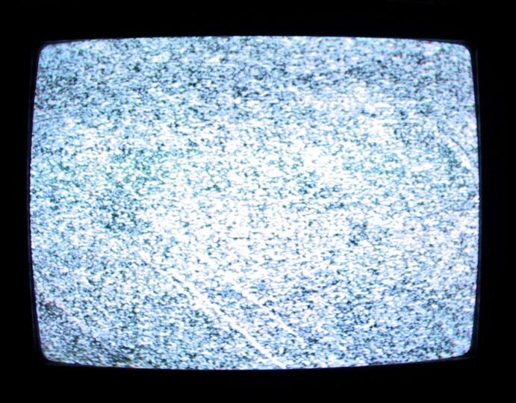
Thermal Noise ≈ White Noise
At most RF and microwave frequencies, the thermal noise from a resistor appear uniform with respect to frequency, as is evident from the absence of a frequency variable in the V_{n} expression
We call this type of frequency independent noise “white noise”
We also note that the noise power is independent of the resistance!

Slide 13
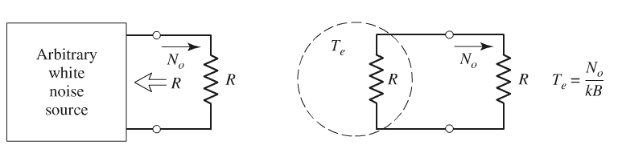
Noise Temperature
If an arbitrary noise source appears to “white”, i.e. frequency independent, it can be approximated by a thermal noise
For a narrow band system, i.e. B is small, the noise can often be approximated as white noise because the frequency dependence is small within B.
In other words, the noise source can be approximated by a resistor with a certain equivalent temperature T_{e}, which is determined by how strong the noise source is
N₀, noise power in bandwidth B

Slide 14
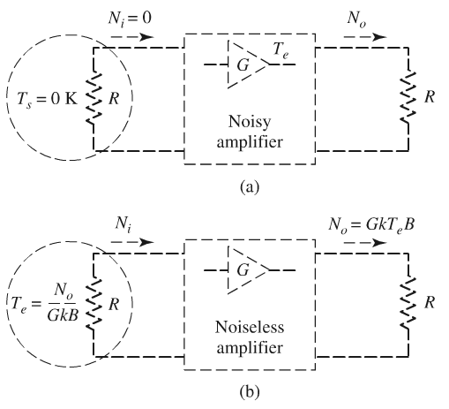
(Input Referred) Noise Temperature of an Amplifier
If you have a “noisy” amplifier, it means that there is noise power even when there is no input (no signal or noise)
If we assume the amplifier to be linear, then a noisy amplifier can be model by a noiseless amplifier with an equivalent noise source at the input
Note:
Both input and output are matched
You have to take the amplifier gain G into account

Slide 15
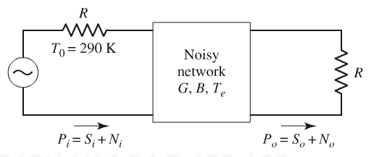
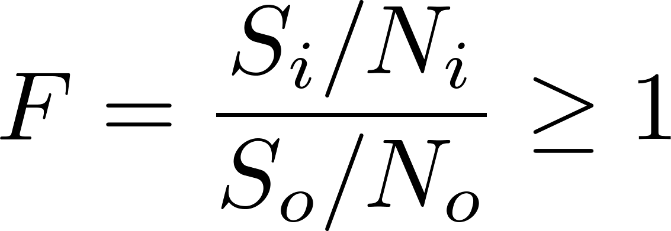
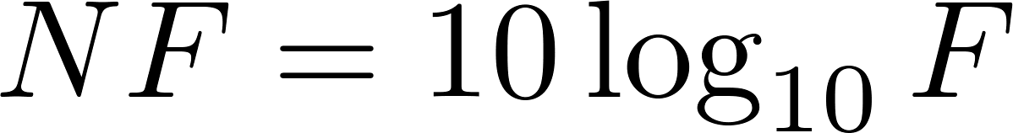
Noise Factor/Figure
We observe that you get more noise at the output; which means that the signal to noise ratio (SNR) is going to degrade after signal passes through an amplifier
It is important to understand that while amplifiers are great at making your signal stronger, they also make noise stronger!!
We define the degradation of SNR, in linear scale, as the noise factor, often denoted by F
Noise factor always greater than 1!
Noise Factor
Noise Figure
More often, you see this ratio specified in dB; we call it noise figure (NF)
NF is more commonly seen in datasheets
NF is always greater than 0 dB

Slide 16
Noise Factor of an Amplifier
In fact, neither noise factor nor noise figure is a very elegant way to specifying the noise of an amplifier because they depend on the input noise level, i.e. they are not intrinsic properties of the amplifier
In addition, noise factor/figure can not describe one port devices
So in order to make sure we can fairly compare different components, noise factor or noise figure are specified under specific conditions:
input is matched to a 50 Ω source resistor
the resistor is held at a specific temperature; by IEEE standard, 290 K

Slide 17
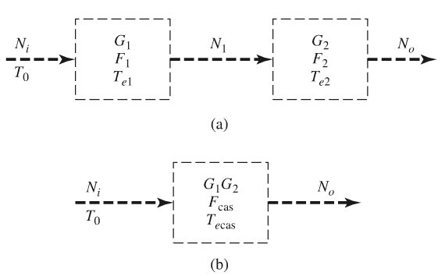
Noise of a Cascade System
The noise contributions from subsequent stages are suppressed by the preceding stages
It follows that the first stage in a cascade system needs to have low noise and high gain
Amplifiers specifically designed to do this are called low noise amplifiers (LNA)
LNAs are often designed for the lowest noise, sacrificing efficiency, linearity, and even gain
To a large extent, LNAs determine the system sensitivity
Important !!

Slide 18
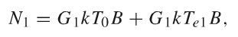
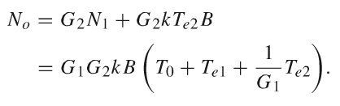
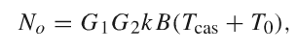
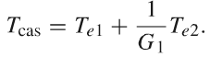
Derivation

Slide 19
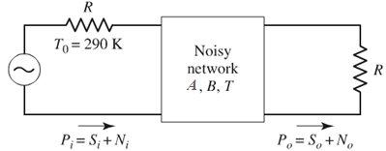
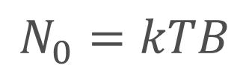
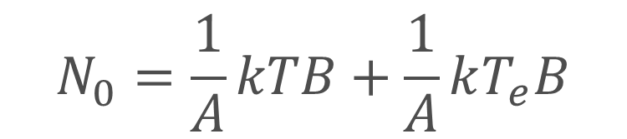
Noise Figure of a Passive, Lossy Element
A = attenuation, defined as P_{in}/P_{out}
B, bandwidth in Hz
T, physical temperature (in Kelvin) of the network
Let’s assume that a resistor at the same physical temperature is connected to the input of the network. Since they are in thermal equilibrium, the resistor+network can be treated as one noise source at T, the output noise power should be
We can also treat the input resistor as the signal source, then the output noise power should be
$$N_{0}=kTB$$
$$N_{0}=\frac{1}{A}kTB+\frac{1}{A}kT_{e}B$$

Slide 20
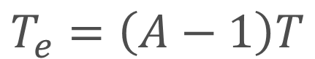
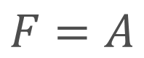
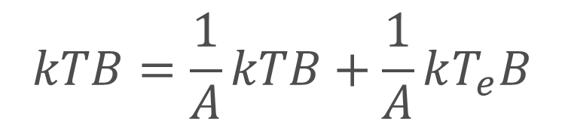
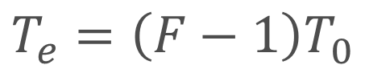
Noise Figure of a Passive, Lossy Element
A = attenuation, defined as P_{in}/P_{out}
B, bandwidth in Hz
T, physical temperature (in Kelvin) of the network
Equating the two
$$kTB=\frac{1}{A}kTB+\frac{1}{A}kT_{e}B$$
$$T_{e}=\left(A−1\right)T$$
Compare with
$$T_{e}=\left(F−1\right)T_{0}$$
$$F=A$$
Important !!
Notes:
Add note on input and output match

Slide 21
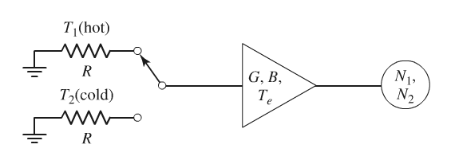
Measurement of Noise Temperature, Figure, Factor
Y-factor method
The idea is simple: measure the noise from two known noise sources and compare the noise power difference at the output

Slide 22
Question: It seems that taking one measurement is enough to calculate T_{e} …
True, but that would be less accurate; you would have to know GB precisely
Taking two measurements allows you to get rid of measurement errors that are common to both measurements
You need two or more measurement points to accurately extrapolate the zero crossing value
Noise power
GkT_{e}B
T₁
T₂
Input noise temperature

Slide 23
Question: Would it help if we take more than two measurements?
Yes, but that would require more noise sources
Good accurate noise sources can be expensive
Getting two noise sources with drastically different noise temperature can also be difficult
Remember that temperature is specified in Kelvin; 0°C and 100°C are only about 30% different
Noise power
GkT_{e}B
T₁
T₂
T₃
T₄
Input noise temperature

Slide 24
Linearity, -- or Non-linearity?

Slide 25
Linearity and Non-linearity
A system is linear if its output can be expressed as a linear combination (superposition) of responses to individual inputs
A
Non-ideal Amplifier
Ideal Amplifier
Notes:
Code for drawing the sine:
#Anacondra spyder environment
# -*- coding: utf-8 -*-
"""
Created on Thu Oct 16 11:55:51 2014
@author: Xiaoguang
"""
import numpy as np
#import scipy.constants
from matplotlib.pylab import *
#constants
pi=3.14159265
#variables
n=300 #number of points to plot
w=2*pi
phi=pi*360/30
t=np.linspace(-1.5,1.5,n)
from numpy import sin, cos, exp
y_f=sin(w*t)
y_3f=0.2*sin(3*w*t+phi)
plot(t,y_f)
savefig('tmp1.eps')
plot(t,y_f+y_3f)
savefig('tmp2.eps')

Slide 26
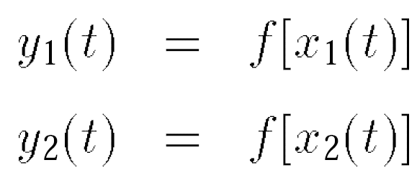
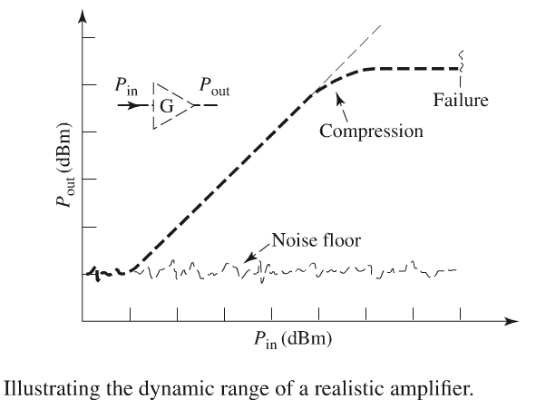
Linearity
A system is linear if its output can be expressed as a linear combination (superposition) of responses to individual inputs
Linear Region

Slide 27
Non-linearity
The input/output characteristic of a memory-less nonlinear system can be approximated with a polynomial
RF/microwave Device or Network
linear
nonlinear

Slide 28
Effects of Non-linearity
Harmonic Distortion
DC
Fundamental
Second
Harmonic
Third
Harmonic
Even-order harmonics result from α_{j} with even j
n^{th} harmonic grows in proportion to V^{n}

Slide 29
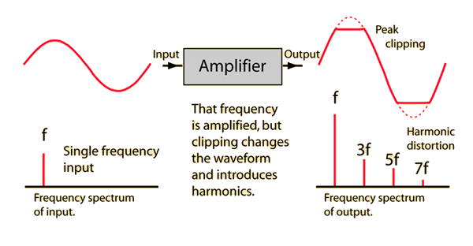
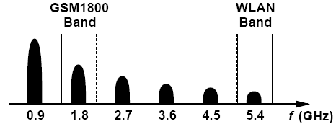
Harmonic Distortion
More signal loss and distortion
Interference to other systems
Sometimes can be used to create frequency multipliers
GSM900 Band
http://hyperphysics.phy-astr.gsu.edu/hbase/audio/amp.html
Notes:
references

Slide 30
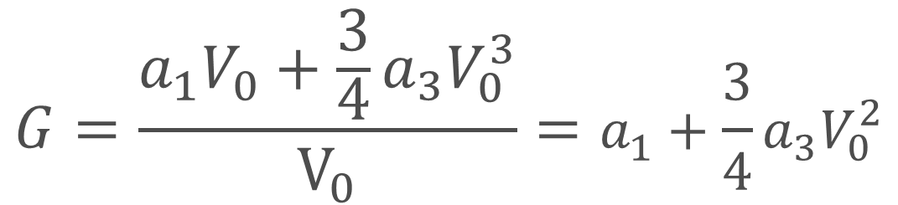
Effects of Non-linearity
Gain Compression
Fundamental
Gain
$$G=\frac{a_{1}V_{0}+\frac{3}{4}a_{3}V_{0}^{3}}{V_{0}}=a_{1}+\frac{3}{4}a_{3}V_{0}^{2}$$

Slide 31
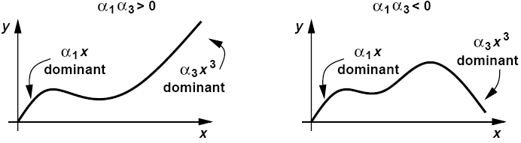
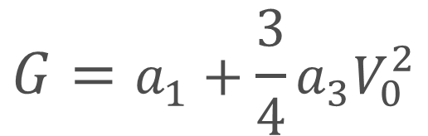
Gain Compression
$$G=a_{1}+\frac{3}{4}a_{3}V_{0}^{2}$$
Expansive
Compressive
Most RF/microwave component/circuits are compressive

Slide 32
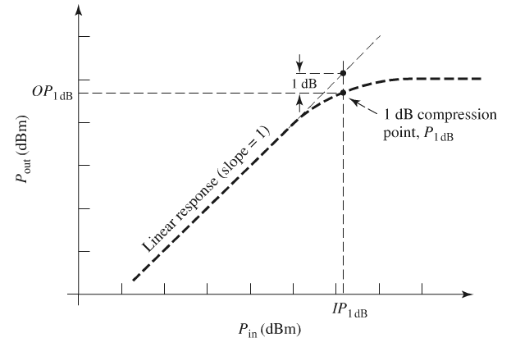
Gain Compression
P_{1dB}: power at 1-dB compression
P_{sat}: power at saturation
If you need very good linearity, you should operate a few dBs below the P1dB point; this is called power back-off
P_{sat}

Slide 33
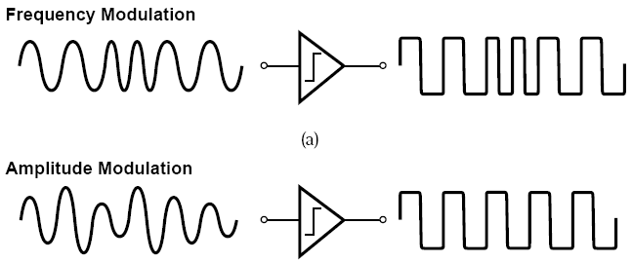
Gain Compression
Effect on modulated signals
FM signal carries no information in its amplitude and hence tolerates compression
AM contains information in its amplitude, hence distorted by compression

Slide 34
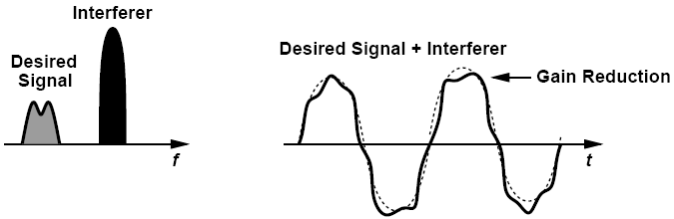
Gain Compression
Desensitization:
the receiver gain is reduced by the large excursions produced by the interferer even though the desired signal itself is small.
Notes:
The same mathematical derivation also shows that the modulation on the interferer can be transferred to the weak signal of interest. This is called “cross modulation”

Slide 35
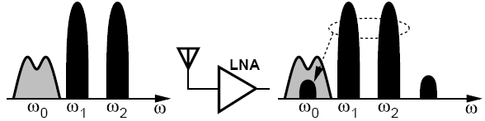
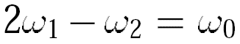
Effects of Non-linearity
Intermodulation
Interferer
desired
A received small desired signal along with two large interferers
Intermodulation product falls onto the desired channel, corrupts signal.

Slide 36
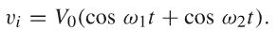
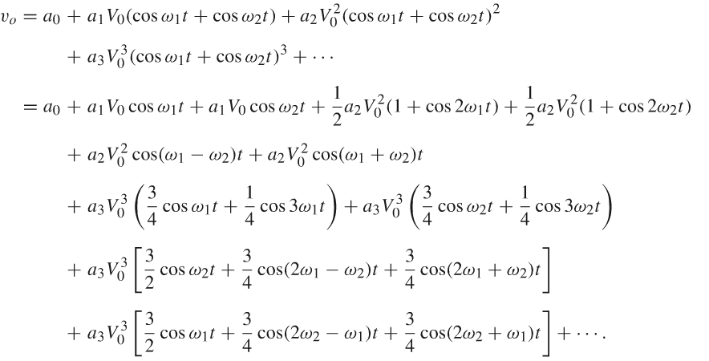
Intermodulation – the Mathematics
Third-order intermodulation
products (IM3)

Slide 37
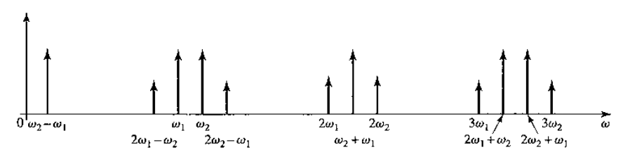
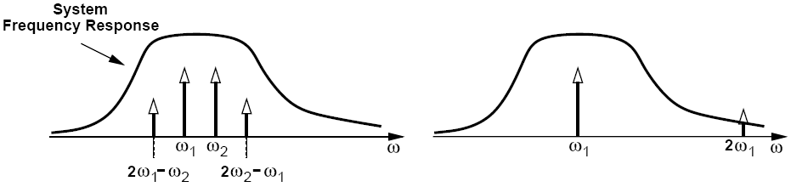
Intermodulation – Two-Tone Test
Two-Tone Test Harmonic Test

Slide 38
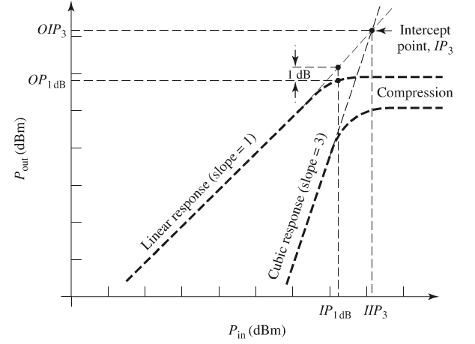
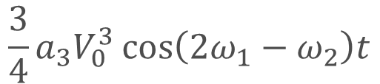
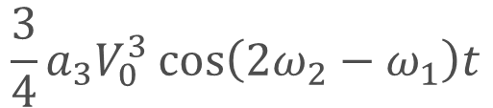
IM3
IM3 products degrades system performance because they are very close to the passband of the system
The power of IM3 products increases more rapidly than the fundamental output when the input power is increased
$$\frac{3}{4}a_{3}V_{0}^{3}\cos\left(2ω_{1}−ω_{2}\right)t$$
$$\frac{3}{4}a_{3}V_{0}^{3}\cos\left(2ω_{2}−ω_{1}\right)t$$

Slide 39
Third-order Intercept Point
Third-order intercept point designates the point where the third-order intermodulation product has the same power as the fundamental output power
The input power at the IP3 point is call input-referred IP3: IIP3
The output power at the IP3 point is call output-referred IP3: OIP3

Slide 40
Third-order Intercept Point
In practice, the amplifier never works close to the IP3 point because it would have saturated way before that
IP3 is extrapolated from measurements of the fundamental output and IM3 products in the linear region of the amplifier
IP3 is really a measure of linearity, rather than power handling
Notes:
In the future, talk about asymmetric IM3 products

Slide 41
An Example of a Real-World RF Amplifier
Power Limitations
Linearity (Amplitude Distortion)
Efficiency
Noise

Slide 42
Efficiency

Slide 43
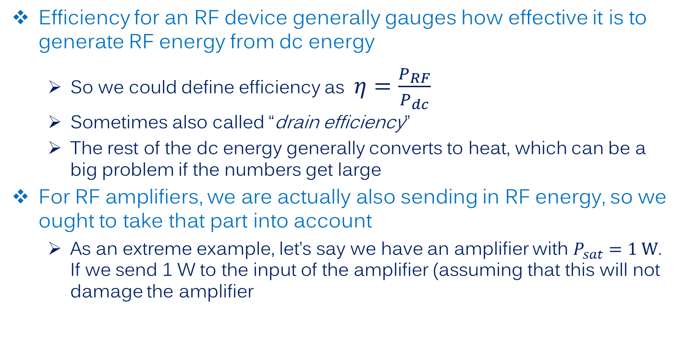
RF Amplifier Efficiency
Efficiency for an RF device generally gauges how effective it is to generate RF energy from dc energy
So we could define efficiency as $η=\frac{P_{RF}}{P_{dc}}$
Sometimes also called “drain efficiency”
The rest of the dc energy generally converts to heat, which can be a big problem if the numbers get large
For RF amplifiers, we are actually also sending in RF energy, so we ought to take that part into account
As an extreme example, let’s say we have an amplifier with $P_{sat}=1 W$. If we send 1 W to the input of the amplifier (assuming that this will not damage the amplifier

Slide 44


Power Added Efficiency (PAE)
$$PAE=\frac{P_{out}−P_{in}}{P_{dc}}$$
Takes care of the input power problem
For high gain (>10 dB), PAE is very close to drain efficiency.
PAE is the highest at the saturation point and degrades as we back off from saturation
High linearity requirement will result in low PAE

Slide 45
Types of RF Amplifiers

Slide 46




Types of RF Amplifiers
Most vendors categorize RF amplifier by their intended use

Slide 47
Types of RF Amplifiers
Common types of RF amplifiers
Low noise amplifiers:
Optimized for low noise and high gain
Power amplifiers:
Optimized for high output power and efficiency
Gain can be moderate if there is no driver included
Variable gain amplifiers
Gain can be changed
Linear amplifier
Optimized for linearity
Gain block/Driver amplifiers
General purpose amplifier with well balanced specs
Wideband amplifiers
Optimized for wide bandwidth; it’s not uncommon to see decade (10:1) bandwidth amplifiers in this category
Bottom line is: look at the quantitative metrics (noise, linearity, power handling, efficiency, size, cost) when choosing your amplifier

Slide 48
RF Amplifier Examples

Slide 49





Low Noise Amplifier (LNA) Examples
Connectorized 2.3 – 2.7-GHz LNA module with 0.8-dB NF (AdaptiveRF, UK)
Waveguide LNA modules up to 100 GHz (NRAO, US)
Packaged LNA IC with 0.27-dB NF (Avago, US)
LNA circuits of a microwave receiver implemented on PCB;
They are easily recognizable as the first block after the antenna feeds (this is a dual-polarization system so there are two feeds)
Notes:
https://science.nrao.edu/facilities/cdl/low-noise-amplifiers
http://www.avagotech.com/pages/en/rf_microwave/amplifiers/low_noise_amplifiers/mga-16116/
http://en.wikipedia.org/wiki/Low-noise_block_downconverter

Slide 50

Low Noise Amplifier (LNA) Examples
A random example: Hittite HMC517LC4
Notes:
https://science.nrao.edu/facilities/cdl/low-noise-amplifiers
http://www.avagotech.com/pages/en/rf_microwave/amplifiers/low_noise_amplifiers/mga-16116/
http://en.wikipedia.org/wiki/Low-noise_block_downconverter

Slide 51


Low Noise Amplifier (LNA) Examples
Notes:
https://science.nrao.edu/facilities/cdl/low-noise-amplifiers
http://www.avagotech.com/pages/en/rf_microwave/amplifiers/low_noise_amplifiers/mga-16116/
http://en.wikipedia.org/wiki/Low-noise_block_downconverter

Slide 52


Low Noise Amplifier (LNA) Examples
Notes:
https://science.nrao.edu/facilities/cdl/low-noise-amplifiers
http://www.avagotech.com/pages/en/rf_microwave/amplifiers/low_noise_amplifiers/mga-16116/
http://en.wikipedia.org/wiki/Low-noise_block_downconverter

Slide 53


Low Noise Amplifier (LNA) Examples
Notes:
https://science.nrao.edu/facilities/cdl/low-noise-amplifiers
http://www.avagotech.com/pages/en/rf_microwave/amplifiers/low_noise_amplifiers/mga-16116/
http://en.wikipedia.org/wiki/Low-noise_block_downconverter

Slide 54




Low Noise Amplifier (LNA) Examples
http://www.digikey.com/product-search/en?FV=fff40036,fff802bc,fffc0467&k=HMC517LC4
Notes:
https://science.nrao.edu/facilities/cdl/low-noise-amplifiers
http://www.avagotech.com/pages/en/rf_microwave/amplifiers/low_noise_amplifiers/mga-16116/
http://en.wikipedia.org/wiki/Low-noise_block_downconverter

Slide 55

Power Amplifier Example
TriQuint TGA2216-SM

Slide 56


Power Amplifier Example

Slide 57

Power Amplifier Example
Notice that the pin layout is drawn flipped!

Slide 58




Power Amplifier Example

Slide 59


Power Amplifier Example

Slide 60

Variable Gain Amplifier
Analog Devices ADL5240

Slide 61

Variable Gain Amplifier
Analog Devices ADL5240

Slide 62

Variable Gain Amplifier

Slide 63



Variable Gain Amplifier

Slide 64


Variable Gain Amplifier

Slide 65

Variable Gain Amplifier

Slide 66
Further Reading
“Fundamentals of RF and Microwave Noise Figure Measurements,” Agilent Application Note 57-1.
“Noise Figure Measurements,” Agilent Presentation, 2009
Iulian Rosu, YO3DAC / VA3IUL, “Automatic Gain Control (AGC) in Receivers, “http://www.qsl.net/va3iul/.
“60 dB Wide Dynamic Range, Low Frequency AGC Circuit Using a Single VGA, “ Analog Devices AN-934 Application Note.

